Slide 1
DART PROGRAMMING SYNTAX
LESSON
02
TMA3084 - Software Engineering Laboratory
Lab Demo: Mr. Raynold Anak Kabai
Lecturer: Madam Nurfauza Binti Jali

Slide 2

Table of contents
01
Introduction
02
main () function
03
Dart Variables and Data Types
04
Input of Information to Dart Program
05
Dart Conditional Operators
06
If…else statements
07
For, While, Do…While loops
08
Break Statements
09
Switch Case Statements
Page

Slide 3
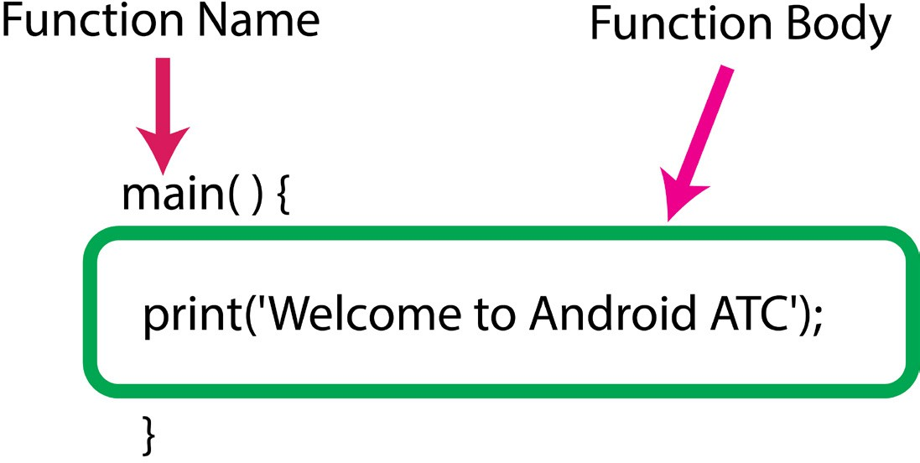
MAIN FUNCTION main()
Every Dart app must have a top-level main() function — it’s the starting point where the program begins to run.
Page

Slide 4
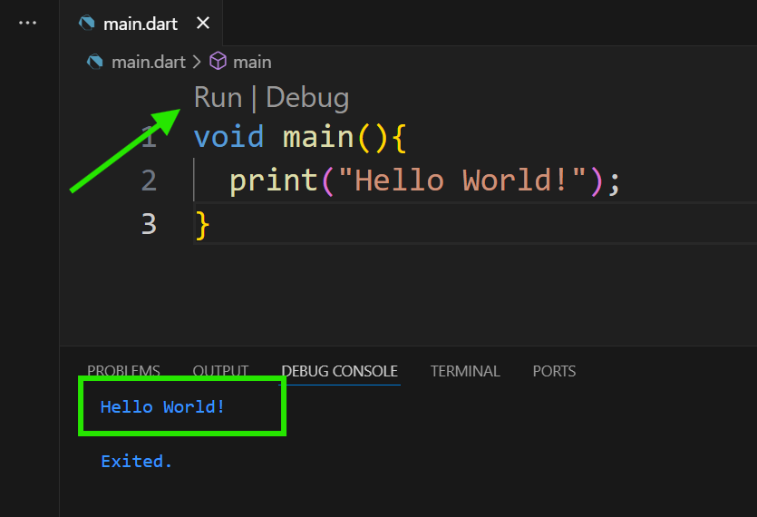
MAIN FUNCTION main()
All your Dart code must be in main() function body
Run this Dart file.
The result follows:
Page

Slide 5
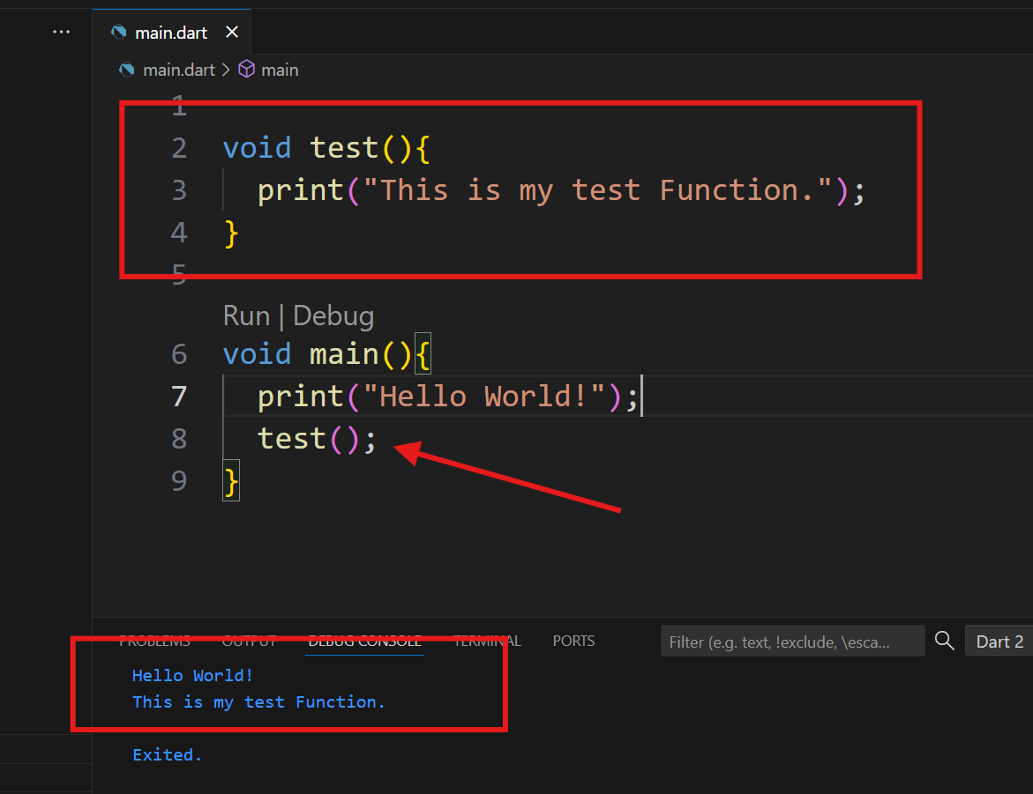
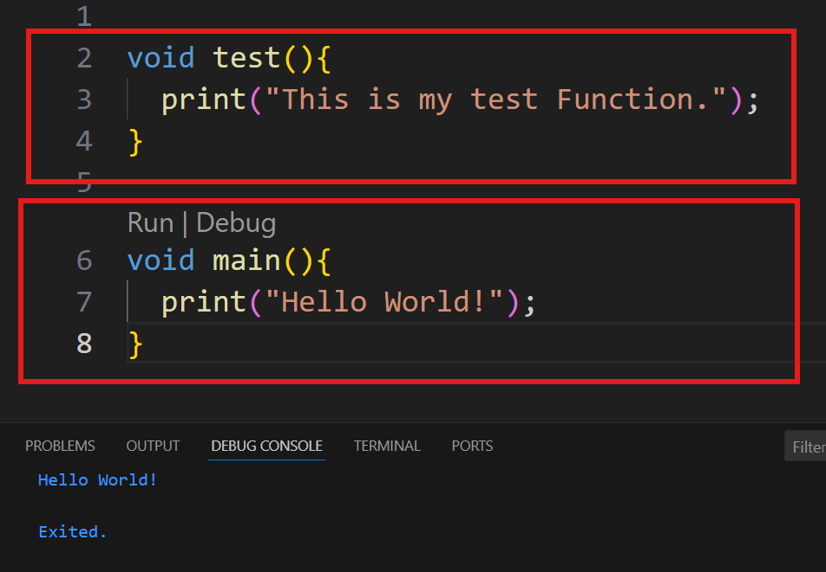
MAIN FUNCTION main()
Outside Function:
If you create a new function and call inside the function it will execute otherwise it is not execute.
Page

Slide 6
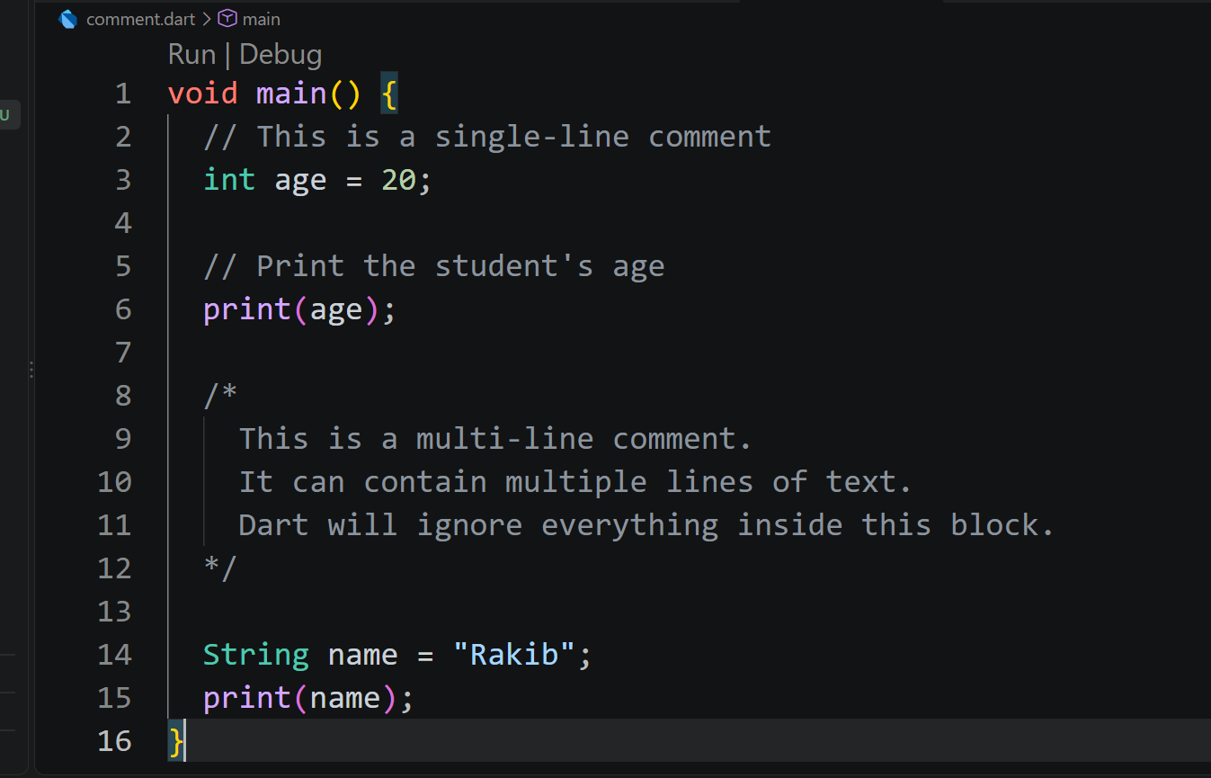
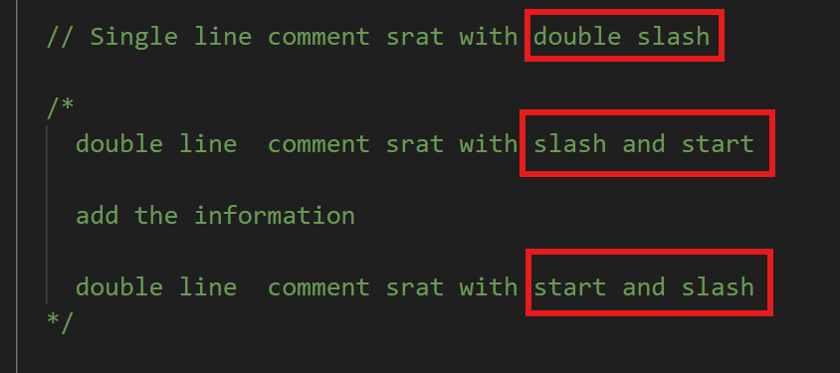
Add the Information to Dart Program
Writing Comments
Any line starting with a double forward slash will be considered a comment by the Dart compiler. This means that this part will not run or appear to the users of this application because it will remain internal. Comments are used to write notes about different parts of the Dart program.
Example:
Page

Slide 7
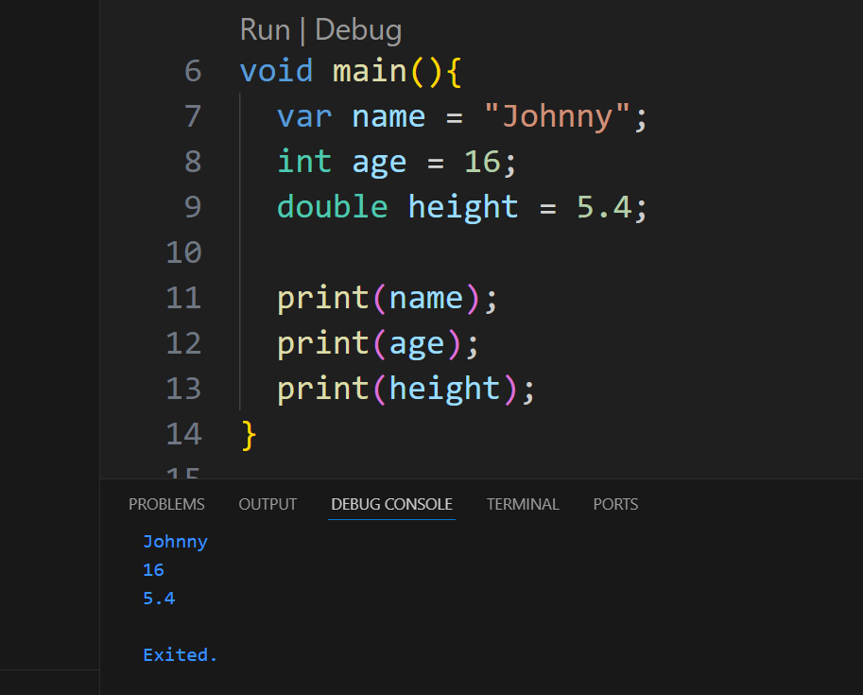
Dart Variables
Dart Variables:
Variables are used to store data values in a Dart program.
You can think of a variable as a container that holds information.
Page

Slide 8
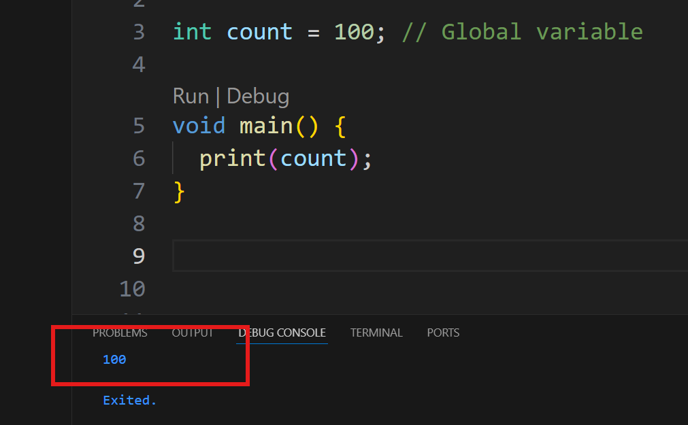
Dart Variables
Global Variable:
A global variable is a variable that is declared outside any function or class and can be accessed from anywhere in the program.
Page

Slide 9
Dart Data Types
Data types define the kind of values a variable can hold.
Common Dart data types include:
int – whole numbers
double – decimal numbers
num – int+double
String – text values
bool – true or false
List – collection of items
Map – key-value pairs
Page

Slide 10
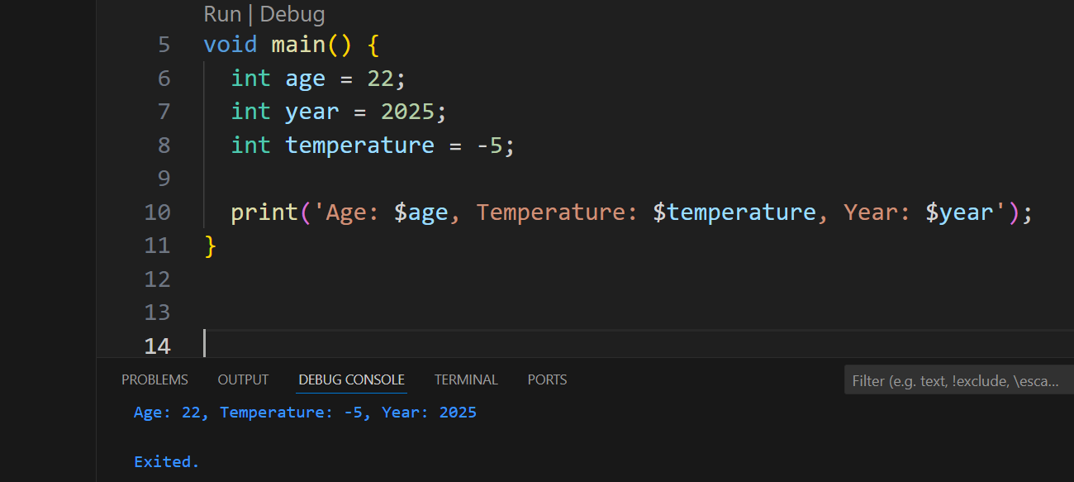
Dart Data Types
int:
The int type is used to store whole numbers, both positive and negative, that do not contain decimal points.
Integers are commonly used for counting, indexing, or working with quantities.
void main() { int age = 22; int year = 2025; int temperature = -5; print('Age: $age, Temperature: $temperature, Year: $year'); }
Page

Slide 11
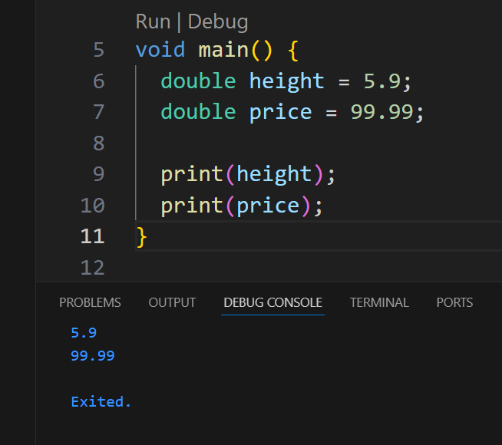
Dart Data Types
double:
The double type stores numbers with decimal points, also called floating-point numbers. It’s useful when you need precise or fractional values like measurements, prices, or percentages.
void main() { double height = 5.9; double price = 99.99; print(height); print(price); }
Page

Slide 12
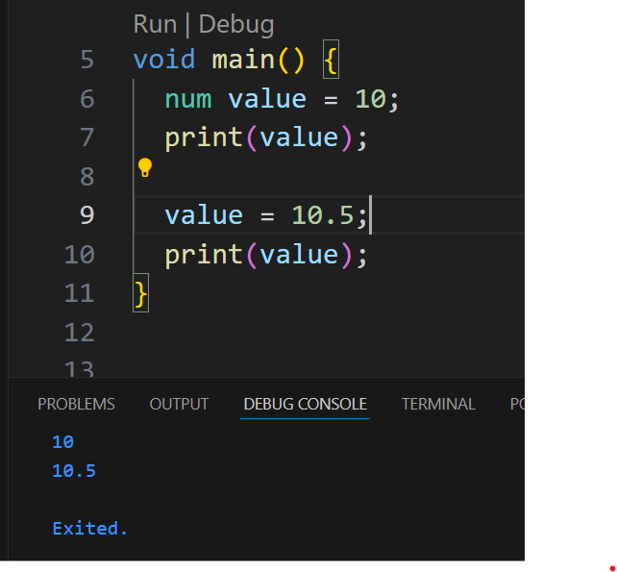
Dart Data Types
Num
The num type can hold both integer (int) and decimal (double) values. It’s flexible when you don’t know whether your number will have decimals or not.
Data Type | Description
Int | The integer data type is a 32-bit signed integer. It has values from -2,147,483,648 to +2,147,483,647
Double | The double data type is a double-precision 64-bit floating point.
void main() { num value = 10; print(value); value = 10.5; print(value); }
Page

Slide 13
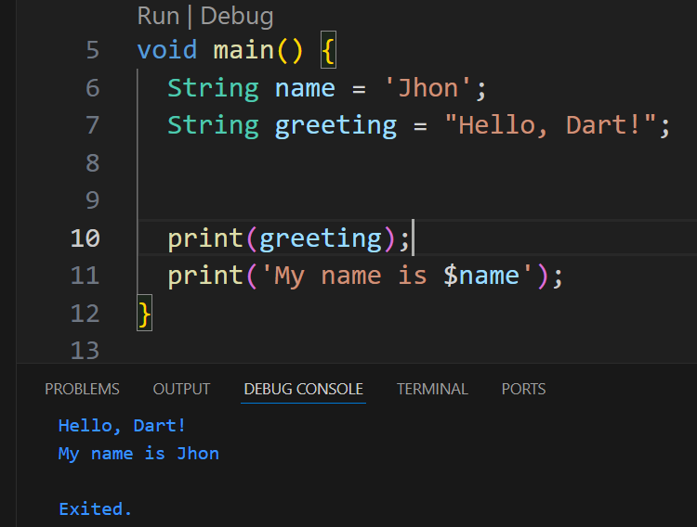
Dart Data Types
String
The String type represents a sequence of characters — letters, numbers, or symbols. It is used for storing text such as names, messages, or any readable information. Strings are enclosed in single (' ') or double (" ") quotes.
Example:
void main() { String name = 'Jhon'; String greeting = "Hello, Dart!"; print(greeting); print('My name is $name'); }
Page

Slide 14
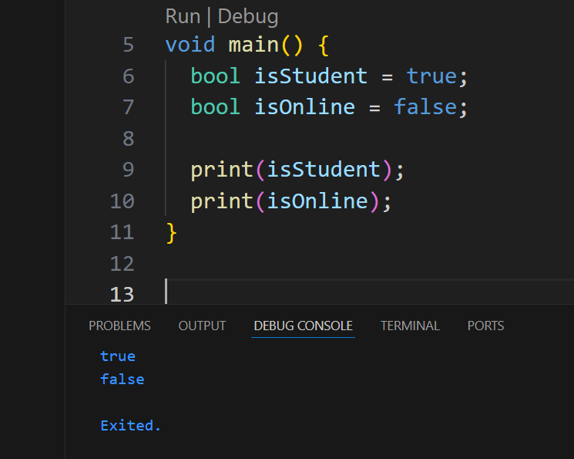
Dart Data Types
bool (Boolean)
Stores only true or false values. A Boolean data type has two possible values; either true or false. Booleans are used in decision making statements which you can control in the program work flow.
Example:
void main() { bool isStudent = true; bool isOnline = false; print(isStudent); print(isOnline); }
Page

Slide 15
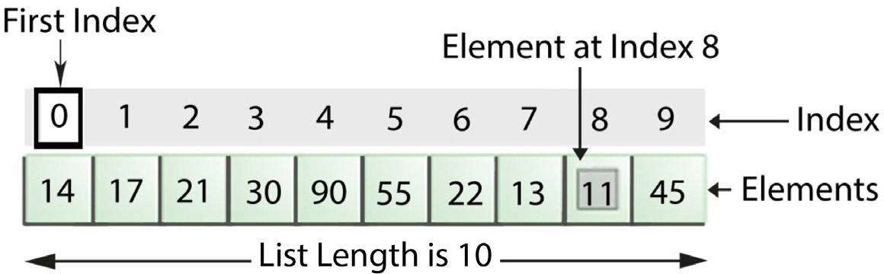
Dart Data Types
List
A very commonly used collection in programming is an array. Dart represents arrays in the form of List objects. If you want to store a large number of data items for the same variable, you need to use the list. A list is used to store a group of values, all of which have the same data type.
As you see in the following figure, this list contains 10 values starting from list [0] whose value is 14 until list [9] whose value is 45.
Page

Slide 16
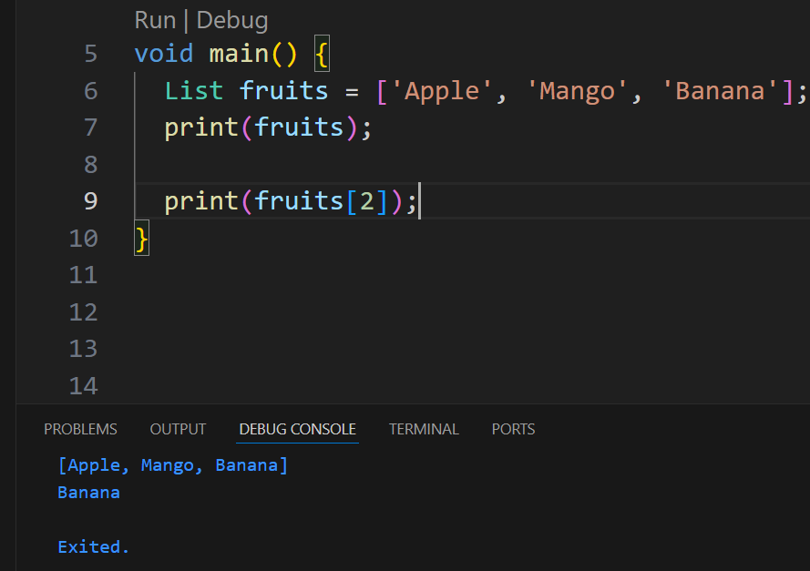
Dart Data Types
List
Lists are great for storing multiple values of the same type (like names, marks, or products).
You can access, add, or remove items using their index number.
void main() { List fruits = ['Apple', 'Mango', 'Banana']; print(fruits); }
Page

Slide 17
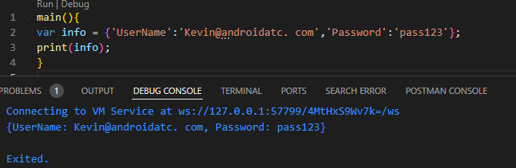
Dart Data Types
Maps
DART maps is an object that associates keys to values. In Dart, maps is an interface designed to manipulate a collection of keys which points to values. Maps can be declared in two ways, using maps literals and using a map constructor as follows:
Declare Maps Using Map Literals
To declare a map using map literals, you need to enclose the key-value pairs within a pair of braces "{ }".
Example:
Page

Slide 18
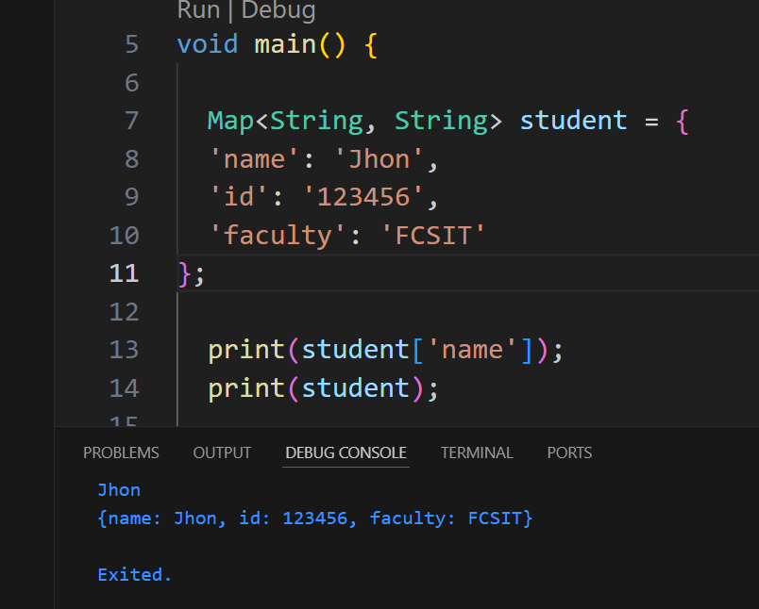
Dart Data Types
Map
void main() { Map<String, String> student = { 'name': 'Jhon', 'id': '123456', 'faculty': 'FCSIT' }; print(student['name']); print(student); }
Page

Slide 19
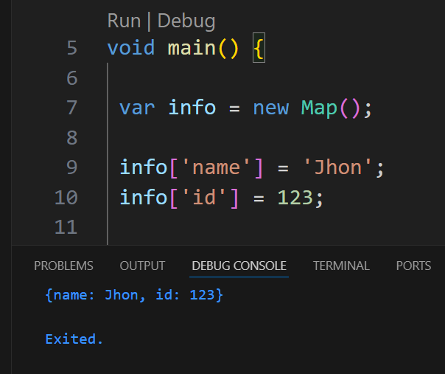
Dart Data Types
Declare Maps Using a Map Constructor:
To declare a Map using a Map constructor, there are two steps. First, declare the map as follows:
var info = new Map();
The second, initialize the map as follows:
void main() { var info = new Map(); info['name'] = 'Jhon'; info['id'] = 123; print(info); }
Page

Slide 20
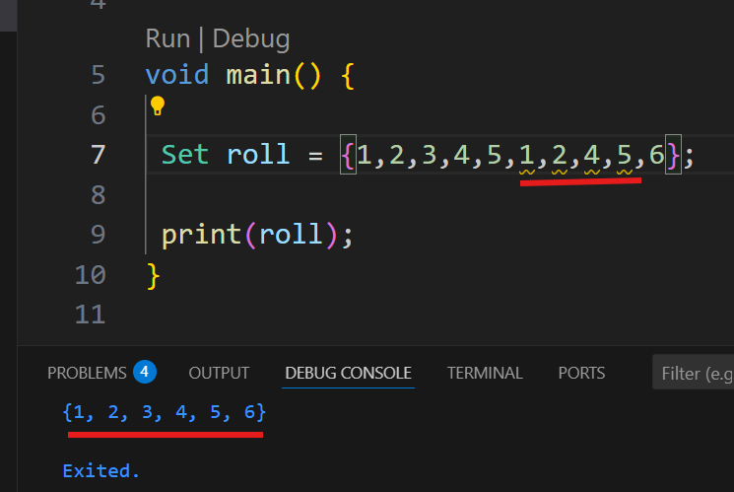
Dart Data Types
Set
A Set is a collection of unique items — it automatically removes any duplicates. Unlike a List, a Set has no fixed order.
Use a Set when you need to store only unique values, like student IDs or email addresses.
void main() { Set roll = {1,2,3,4,5,1,2,4,5,6}; print(roll); }
Page

Slide 21
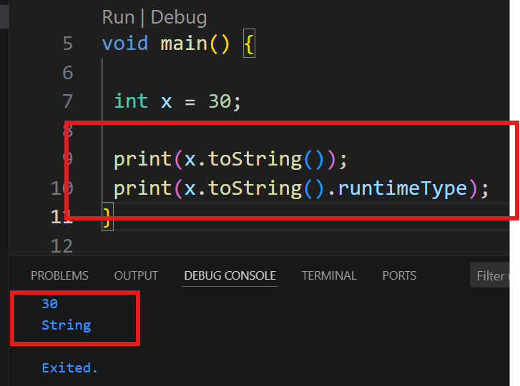
Dart Data Types
Data type Conversions
In some cases, you may need to convert a data type for a variable to another data type such as changing an Integer to a String. To do that, you need to use toString() function explicitly to convert the variable to data type String, as illustrated in the following figure:
void main() { int x = 30; print(x.toString()); }
Page

Slide 22
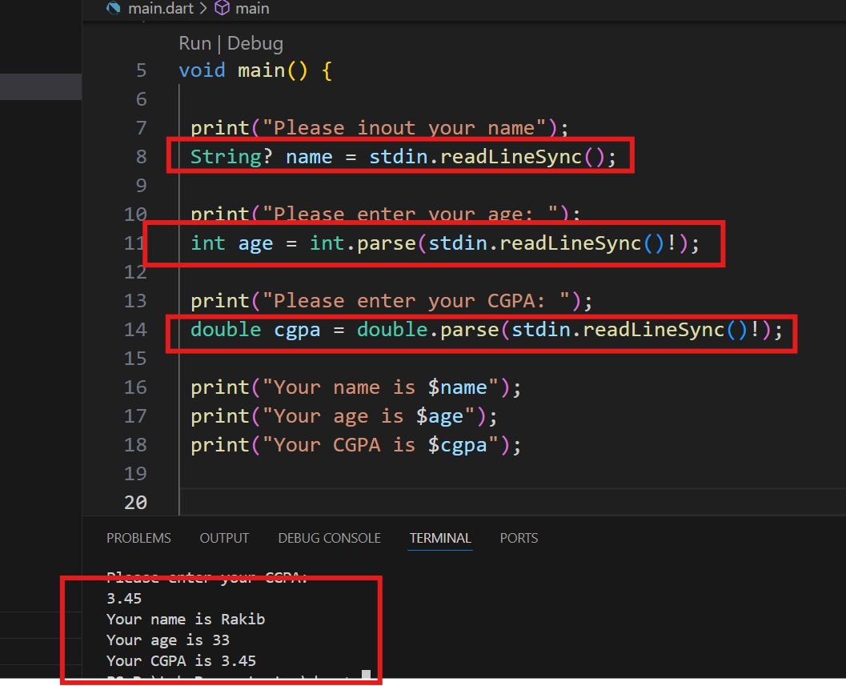
Input of Information to Dart Program
Input of Information to Dart Program
stdin.readLineSync() function allows the program user to enter string values or intercept keyboard input from the console as shown in following example:
Here, at the first line of code, add : import 'dart:io' to import the dart:io library. This library allows IntelliJ to accept the input of information commands.
import 'dart:io'; void main() { print("Please inout your name"); String? name = stdin.readLineSync(); print("Please enter your age: "); int age = int.parse(stdin.readLineSync()!); print("Please enter your CGPA: "); double cgpa = double.parse(stdin.readLineSync()!); print("Your name is $name"); print("Your age is $age"); print("Your CGPA is $cgpa"); }
Page

Slide 23
Dart Conditional Operators
The following table includes some conditional operators that help in the control flow of the Dart program:
Operator | Description
== | Equal to
=! | Not Equal to
< | Less than
=< | Less than or equal to
< | Greater than
=< | Greater than or equal to
? | Return value of two expressions
?? | Return the which is not equal null value of two expres- sions
is | Is
!Is | Is Not
Page

Slide 24
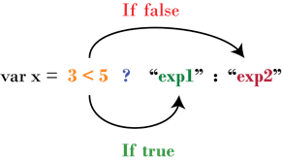
Dart Conditional Operators
In the following code, you will test the role of double equal sign "==" which is used to compare if two values are equal or not. If they are equal, then the run result will be true; otherwise, the run result will be false.
main() { int x=3; int y=5; print(x == y); }
The following Dart conditional operator "?" will return one expression (exp1 or exp2) as illustrated in the following figure :
Page

Slide 25
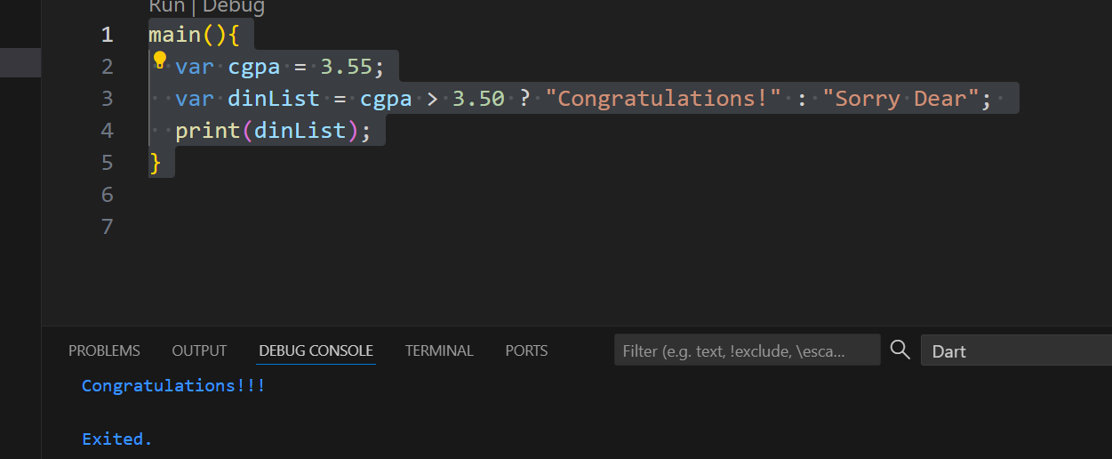
Dart Conditional Operators
The ternary operator in Dart is a short way to write an if–else statement in a single line.
condition ? expressionIfTrue : expressionIfFalse;
main(){ var cgpa = 3.55; var dinList = cgpa > 3.50 ? "Congratulations!" : "Sorry Dear"; print(dinList); }
Page

Slide 26
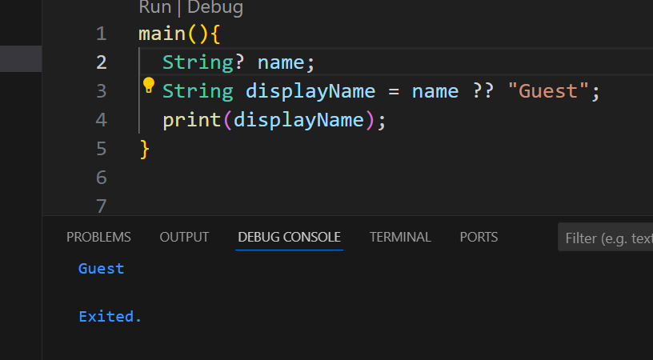
Dart Conditional Operators
?? is called the null-coalescing operator in Dart. It means “use the value on the left if it’s not null; otherwise, use the one on the right.”
main(){ String? name; String displayName = name ?? "Guest"; print(displayName); }
Page

Slide 27
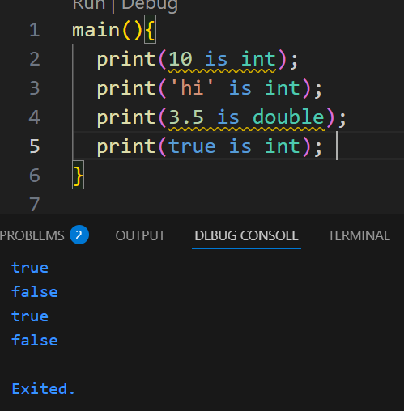
Dart Conditional Operators
What is does: The is operator checks whether a variable is of a certain type. It returns a boolean value (true or false).
main(){ print(10 is int); print('hi' is int); print(3.5 is double); print(true is int); }
Page

Slide 28
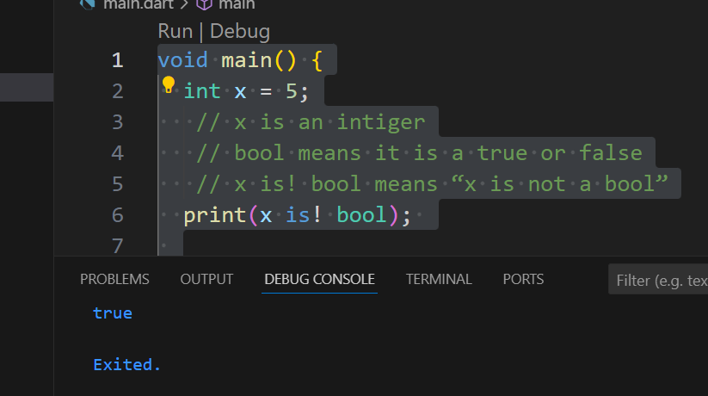
Dart Conditional Operators
What is does: The is operator checks whether a variable is of a certain type. It returns a boolean value (true or false).
void main() { int x = 5; // x is an intiger // bool means it is a true or false // x is! bool means “x is not a bool” print(x is! bool); }
Page

Slide 29
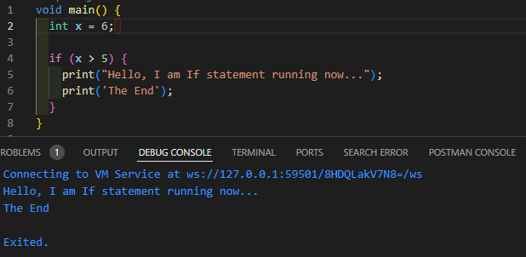
If Statement
The "if" statement is a programming conditional statement that, if proved true, executes the second part of the statement. Otherwise, if proved false, the program will skip the execution of the second part and do something else.
void main() { int x = 6; // Define a value for x if (x > 5) { print("Hello, I am If statement running now..."); print('The End'); } }
Page

Slide 30
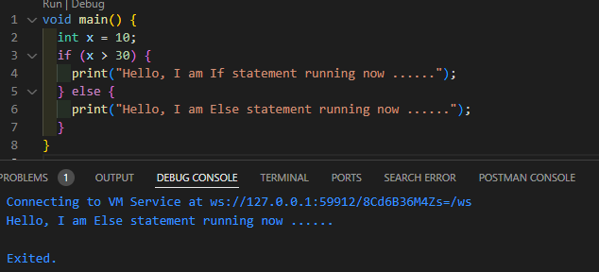
Else If Statement
If-Else Statement
The if-else statement is the most basic of all the control flow statements. It invokes your program to execute a specific section of a code only if a particular test proves to be true. The following figure displays the work of the IF - Else statement:
void main() { int x = 10; if (x > 30) { print("Hello, I am If statement running now"); } else { print("Hello, I am Else statement running now"); } }
Page

Slide 31
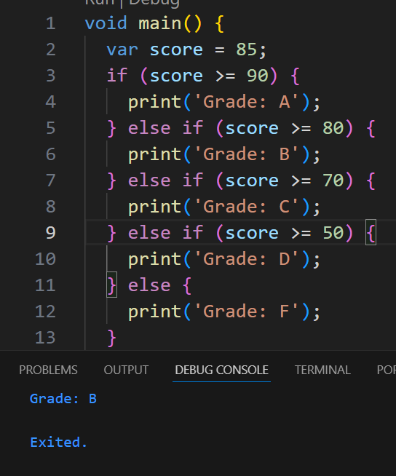
Else If Statement
IF…Else and Else…IF... Statement
This statement is the most basic of all control flow statements. It invokes your program to execute a certain section of code only if a particular test evaluates to be true.
An if-statement can be followed by an optional else-if-else statement when testing multiple conditions.
The following code displays how if-else and else-if statements work:
void main() { var score = 85; if (score >= 90) { print('Grade: A'); } else if (score >= 80) { print('Grade: B'); } else if (score >= 70) { print('Grade: C'); } else if (score >= 50) { print('Grade: D'); } else { print('Grade: F'); } }
Page

Slide 32
If logic Statement
IF Else and Logical Operators
Logical operators like AND "&&" and OR "| |" may be utilized within if-else statements. If you have two conditions (i.e. multiple Boolean expressions) which must be true or one of them is enough to make the statement true respectively, logical operators "if" statement may be used to test more than one condition at the same time.
The following table displays the | | (OR) operator results (true or false) of the two Boolean expressions. These results will be considered by the "if" statement:
Boolean Expressions (Condition): A | Boolean Expressions (Condition): B | A || B
True | True | True
True | False | True
False | True | True
False | False | False
Page

Slide 33
If logic Statement
IF Else and Logical Operators
The following table displays the use of "&&" (AND) logical operator to guarantee that the two conditions are true:
Boolean Expressions (Condition): A | Boolean Expressions (Condition): B | A &&B
True | True | True
True | False | False
False | True | False
False | False | False
Page

Slide 34
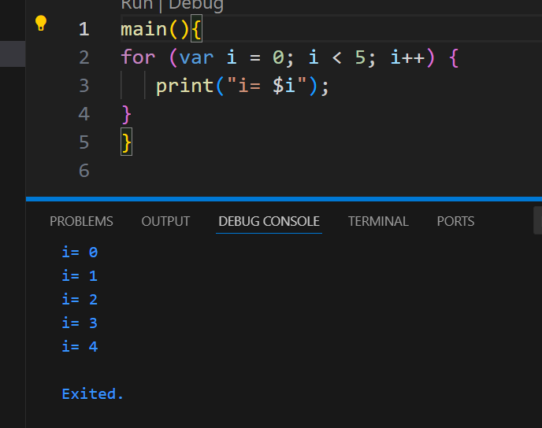
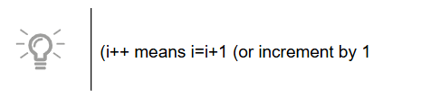
For Loops
A for statement provides a compact way to iterate over a range of values. Programmers often refer to it as the "for-loop" because it repeatedly loops until a particular condition is satisfied.
The following is an example of how the for-loop works:
Page

Slide 35
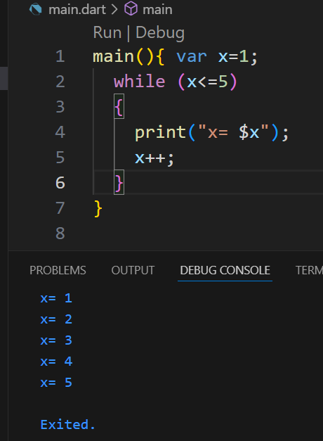
WHILE Loops
While Loops
A while-statement depends on a Boolean expression and its counter. If the expression proves to be true, the While statement executes the statement(s) in the While block. The while statement continues testing the expression and executing its loop until the expression is proved false.
The following example explains how While loops work:
main(){ var x=1; while (x<=5) { print("x= $x"); x++; } }
Page

Slide 36
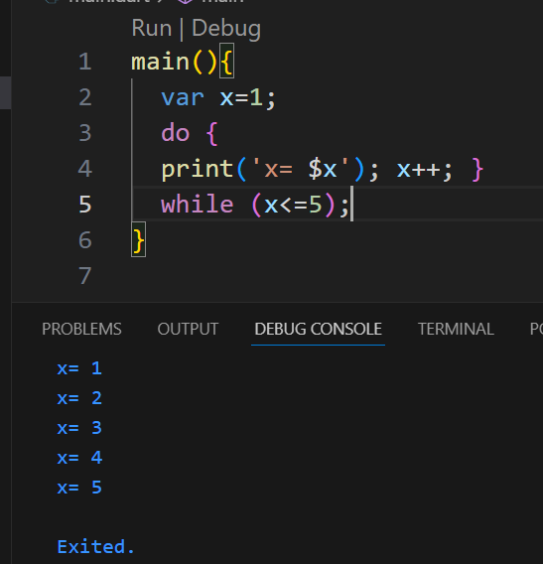
Do WHILE Loops
Contrary to the while-loop, the Do-while loop starts evaluating its expressions from the bottom and not from the top. Thus, the statements within the do block are executed at least once. Do-while loops are exit controlled loops, i.e. the compiler will first execute the code block associated with the Do-while loop, and then check the associated Boolean expression. If the Boolean expression proves to be true, the compiler will loop and execute the Do-while code block again, or else, the compiler will skip the Do-while code block and continue to execute the statements that follow the Do-while loop.
main(){ var x=1; do { print('x= $x'); x++; } while (x<=5); }
Page

Slide 37
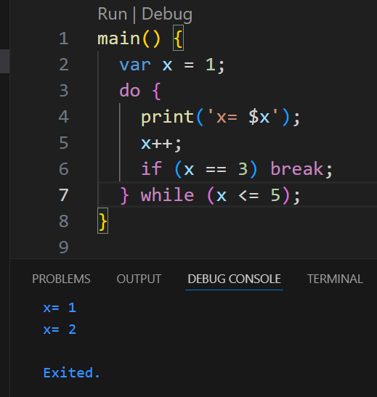
Break Statements
Break Statement:
The break statement is used to exit a loop immediately, skipping the rest of its normal execution. When the program encounters a break inside a loop, it stops the loop and continues with the next statement after it.
You can use break in while, do-while, or for loops.
Example: In a do-while loop, if the variable x becomes 3, the break statement stops the loop and the program continues with the next line after the loop.
main() { var x = 1; do { print('x= $x'); x++; if (x == 3) break; } while (x <= 5); }
Page

Slide 38
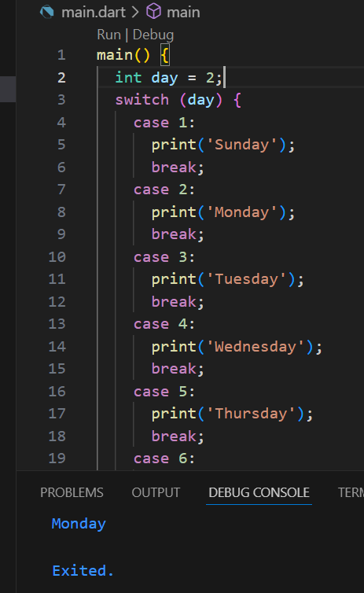
Switch Case Statement
Switch Case Statement
In Dart, a switch case is a shorter and cleaner alternative to multiple if–else statements. It checks an expression against several cases to decide which block of code to run.
Example: If day = 2, the program runs case 2, sets the variable to “Monday,” and then exits the switch using break. If no case matches, the default case runs.
main() { int day = 2; switch (day) { case 1: print('Sunday'); break; case 2: print('Monday'); break; case 3: print('Tuesday'); break; case 4: print('Wednesday'); break; case 5: print('Thursday'); break; case 6: print('Friday'); break; case 7: print('Saturday'); break; default: print('Invalid Day'); } }
Page

Slide 39
Lab 2: Create a Pizza Order Program
Switch Case Statement
In this lab, you will create a Dart program using simple Dart syntaxes. This lab is just to practice using some code you have learned in lesson 2.
Here, you will create a simple pizza order calculator so that when you run this program, the program will ask the user to enter the pizza size and the quantity of pizza the user wants. Then, the output of the run result will be the total of the user payment.
To create this Dart program, follow the steps below:
Open VSC
Create New Text File. Save it as main.dart
At the top of the code, type the following code to enable the input library
Page

Slide 40
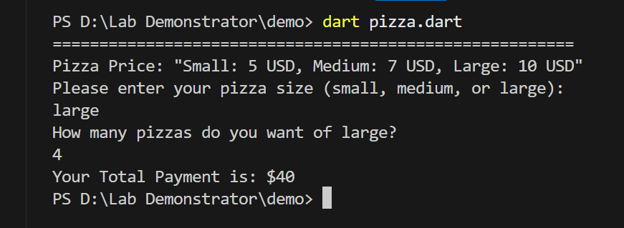
Lab 2: Create a Pizza Order Program
First line show the Pizzas Price:
Pizza Price: Small: 5 USD, Medium: 7 USD, Large: 10 USD
Second Line Show the Pizza Size:
Please enter your pizza size (small, medium, or large)
After input Show the message How many pizza want?
  How many pizzas do you want of pizza_size?
Then we input your pizza size and how many pizza we need.
Page

Slide 41
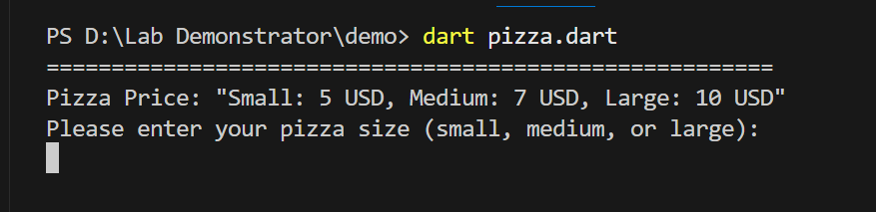
Lab 2: Create a Pizza Order Program
Run the Program
Page

Slide 42
Any Questions?

Slide 43
Thank you

